Slide 1




Modelling the potential health and economic impact of paediatric vaccination using next generation influenza vaccines in Kenya, UK and Thailand
Funders:

Slide 2









The team
Kenya
Mark Jit
Professor of Vaccine Epidemiology, LSHTM
Marie Mazur
Taskforce for Global Health
Jeannette Dawa
Washington State University – Global Health Programs, Kenya
Rosalind Eggo
Associate Professor, LSHTM
Honorary position in Vaccine Evaluation, UKHSA
HDR UK Innovation Fellow
UK
Joseph Bresee
Taskforce for Global Health
Edwin van Leeuwen
UK Health Security Agency & LSHTM
Investigators
Key collaborators
Naomi Waterlow
Research Fellow, LSHTM
Thailand
Sreejith Radhakrishnan
Research Fellow, LSHTM
Ben Cooper
University of Oxford & Mahidol-Oxford Tropical Medicine Research Unit
Aronrag Meeyai
University of Oxford

Slide 3
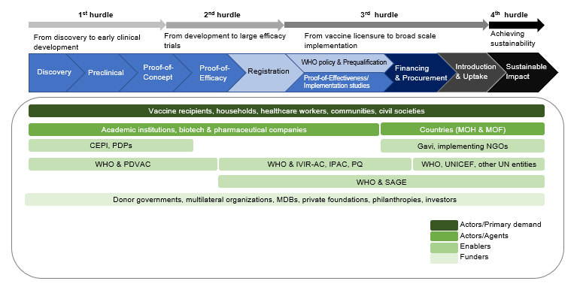
Next gen flu vaccination: full value of vaccines assessment
Key question
“Should we invest in developing a next gen flu vaccine?”
“Should we recommend/fund a next gen flu vaccine?”
“Should we introduce a next gen flu vaccine?”
From Hutubessy et al. https://ssrn.com/abstract=3841999. Also discussed at Fondation Mérieux consultation, 5-7 December 2016; WHO Product Development for Vaccines Advisory Committee (PDVAC) Consultation, 26-28 June 2019, Wilder-Smith et al. BMC Medicine 2017; 15:138 etc.

Slide 4
Programme of work
Year 3
Dec 2023 – Dec 2024
Year 1
Dec 2021 – Jan 2023
Year 2
Feb 2023 – Nov 2023
Status:
almost complete
Status:
Funding secured pending contracting
Status:
In discussions about funding
Use calibrated models of seasonal influenza in Kenya, UK and Thailand
Compare the impact and cost-effectiveness of current vs. next generation influenza vaccines
Extrapolate model results to other parts of the world
Analyse the potential global impact and cost-effectiveness of next generation vaccines
Link epidemiological and economic modelling to supply and demand models to support a full value of vaccines assessment
Explore the impact of next generation vaccines on antibiotic use and antimicrobial resistance
Notes:
Year 1 (Dec 2021 – Jan 2023)
Year 2 (Feb 2023 – Nov 2023) subject to funding
Extrapolate model findings to other parts of the world
Analyse the global impact and cost-effectiveness of vaccine
Year 3 (Dec 2023 – Dec 2024) Further work in discussion with WHO

Slide 5

Next Generation Flu Vaccines: WHO PPC
 | Improved influenza vaccines | Universal influenza A vaccines
Projected year of licensure | 2022 | 2027
Target population | Children 6-59 months old | All clinical risk groups including children 6-59 months old
Duration of protection | At least one year/influenza season (equal or better than current vaccines) | At least 5 years
Clinical efficacy | Better than current vaccines for either vaccine-matched or drifted strains | Better than current vaccines for vaccine-matched AND drifted strains

Slide 6
Main vaccine scenarios of interest
Scenario | Efficacy (well matched) | Efficacy (poorly matched) | Duration of protection
No vaccine
Current | 70% | 40% | 6 months
Improved– minimal | 70% | 40% | 1 year
Improved– breadth | 70% | 70% | 3 years
Improved– efficacy | 90% | 70% | 2 years
Universal | 90% | 90% | 5 years

Slide 7
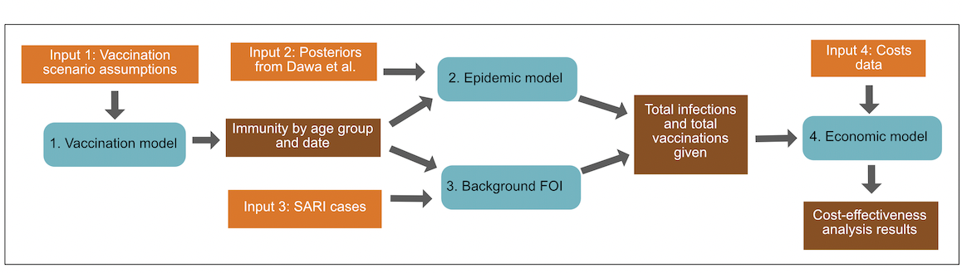
Model structure

Slide 8
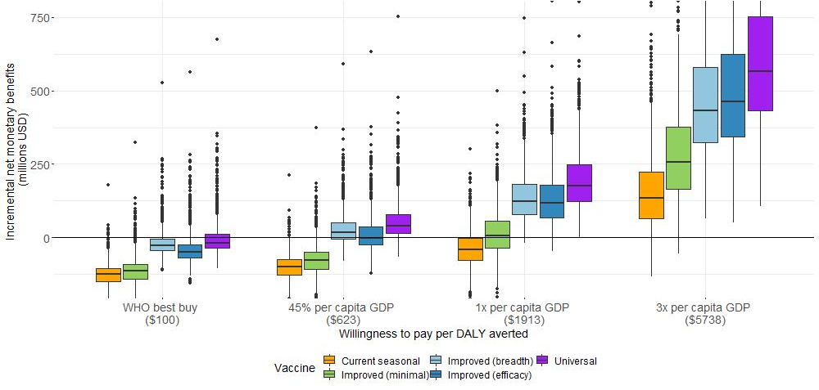
Results: Kenya
All vaccines assumed to cost $3/dose.
https://www.medrxiv.org/content/10.1101/2022.08.26.22279262v1

Slide 9
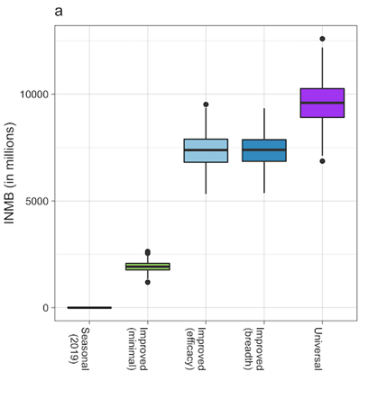
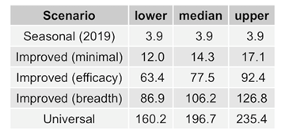
Results: United Kingdom
Threshold price per dose (GBP):
With WTP threshold of £20,000/QALY gained

Slide 10
Preliminary results: Thailand

Slide 11
Conclusions and next steps
Next generation influenza vaccines are likely to result in fewer influenza cases and deliver greater health benefits than currently available seasonal vaccines.
Universal vaccines have the greatest value, and are likely to be cost-effective across a range of prices, willingness-to-pay thresholds and geographies.
However, even slightly improved vaccines are likely to deliver large benefits if they can extend the duration of protection of influenza vaccination.

